Slide 1

Western Power Distribution
LV Templates Project
Discussion of findings on ratings of LV PV installations
DECC UK PV Solar Strategy Group – Grid Connection Sub-Group
November 4th 2013
Phil West
Western Power Distribution

Slide 2
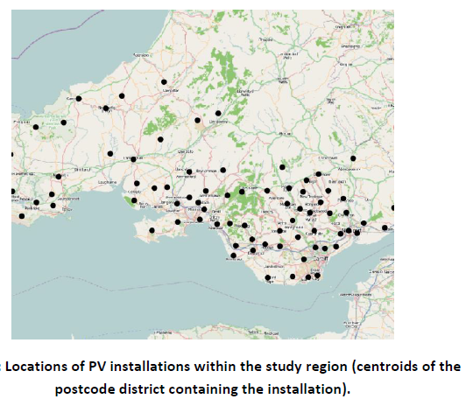
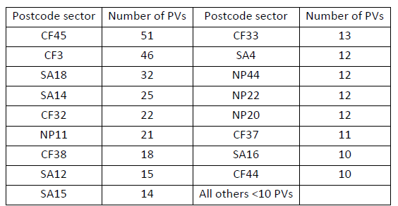
LV Templates Project – 525 monitored LV PV installations

Slide 3
Project finding – 525 installations over a year

Slide 4
Wide potential for variability in derivation of stated kW rating

Slide 5
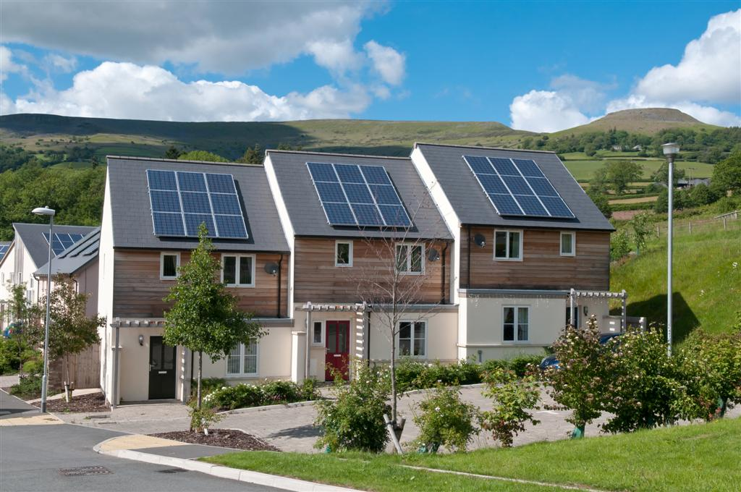
Note directions of PV cells and shadows

Slide 6
International specification of panels

Slide 7
International specification of panels – panel temperature coefficient

Slide 8
International specification of panels – irradiation value based on 1000W/m2

Slide 9
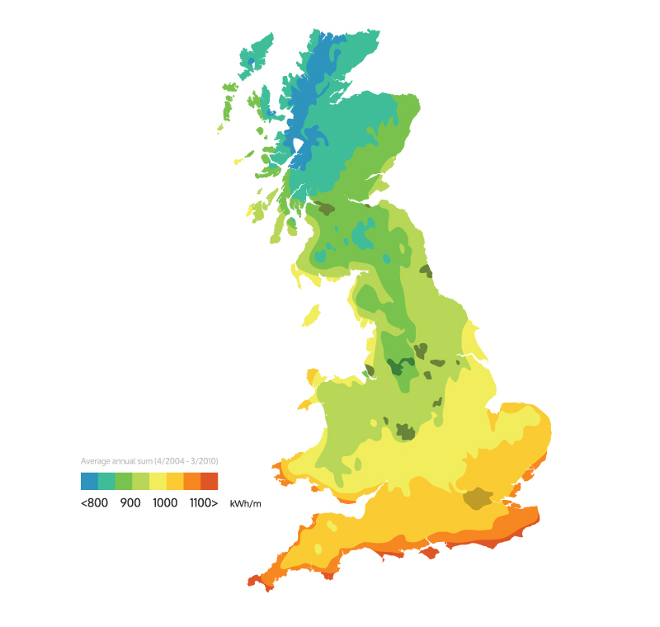
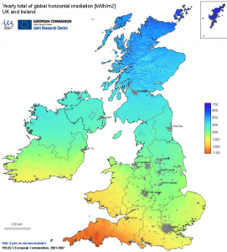
Variation in data sources on irradiation
UK Irradiation map from website of
Evoenergy.co.uk
UK irradiation map from website of
energymyway.co.uk

Slide 10

Sample on line calculator –
How you can use the solar irradiance calculator information
The information from the solar irradiance calculator can be used to calculate the amount of power you can get from different forms of solar energy systems:
To calculate the amount of solar energy you will get from a photovoltaic solar panel for an average day in any given month, for example, multiply the stated wattage of the solar panel by 75% (to account for inefficiencies in the power generation and capture) and then multiply it by the kWh/day figure for the month in question.
stated wattage of panel x 75% x monthly insolation figure = average daily power

Slide 11
Referenced “Proxy FiT meters report available at –
http://lowcarbonuk.com/downloads/PvFITProxy.pdf
Phil West – Western Power Distribution
pwest@westernpower.co.uk
07703 503417

